Slide 1
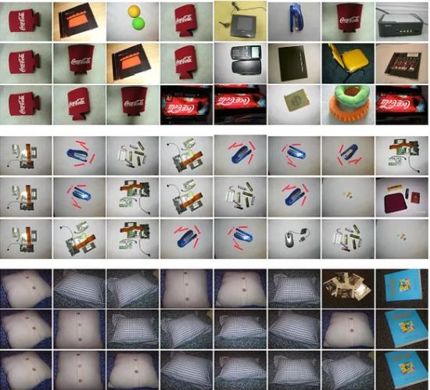

IMAGE DEDUPLICATION
(IMDEDU)
Olubunmi Emmanuel Ogunleye
Selva Ganapathy Elangovan
Special Project Presentation
Name Of Advisor: Prof. Björn Rüffer
07-03-2025

Slide 2
Introduction/Motivation | 03
Aim and Objectives | 04
Literature Review | 05 - 08
Methodology | 09 - 10
Results and Discussion | 11 - 12
Conclusion/Findings | 13
Limitation of Study | 14
Recommendation | 15
References | 16
Project Presentation Outline
02

Slide 3

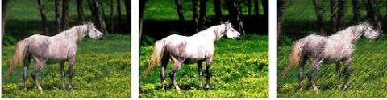
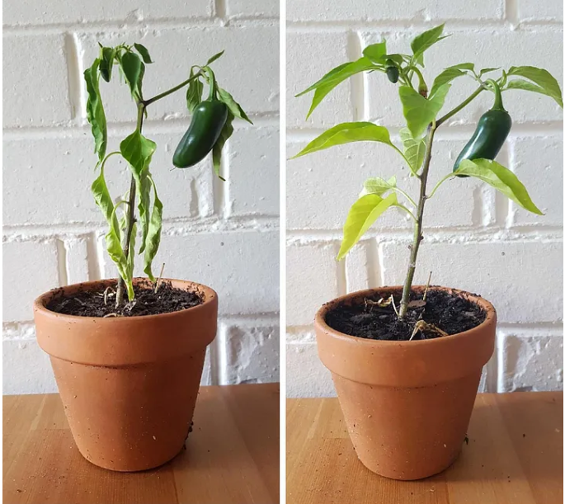
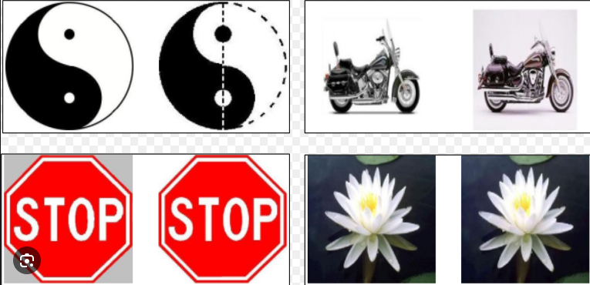
Introduction / Motivation
How Do We Detect
Image Duplicates?
Significance #1
Eliminate Multiple Versions of Same Image
Significance #2
Efficient Usage of Data Storage Space
Significance #3
Reduce Search Complexity in Information Retrieval
03

Slide 4
Aim and Objectives
Aim is to Implement an Algorithm that Detects Near Duplicates.
01
02
03
04
Implement a way to gather collection of images from data storage
Define metric to measure similarities between images
Implement a technique to cluster similar images
Determine the best version of a group of similar images
04

Slide 5
Literature Review
Theory 01
Hash Functions
Mathematical algorithm that transforms data into fixed strings of bit called hash codes.
(Ref: Stallings, 2017)
Theory 02
Cryptographic Hashes
Unique and consistent output for any given input. Minor change result in significantly different hash value. Collision Resistant. Examples: MD5, SHA-256 (Ref: Schneier, 2017)
Theory 03
Perceptual Hashes
Finding similarities between Images.
Collisions can occur.
Produces similar hash values for similar images.
(Sharma, 2014)
Theory 04
Similarity Distance Measures
Used to cluster similar images. Examples Euclidean, Hamming, Manhattan etc.
05

Slide 6
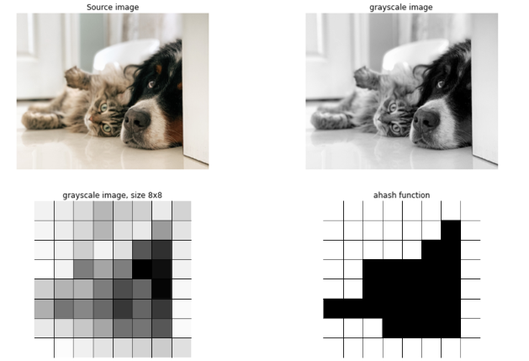
Literature Review Cont’D
Types of Perceptual Hashes (Ref: Viies, 2015)
Average Hash Averages the pixel values. Computationally Efficient
Median Hash Uses Median Pixel Values. Robust to Certain Image Modification
Perceptual Hash Uses Discrete Cosine Transform. Robust to scaling and Rotations
Wavelet Hash Uses Discrete Wavelet Transformation. Also extract hash values from low frequencies.
06

Slide 7
Literature Review Cont’D
Average Hashing (Ref: Viies, 2015)
Step 01 Resize image into a fixed dimension 8x8 pixels
Step 03 Determine the Average Pixel Value
Step 05 Convert Binary String to Hexadecimal Strings
01
03
05
02
04
Step 04 Compute Binary Hash Value by Thresholding with Average Pixel Value. Result is a Binary String
Step 02 Convert resized image to Grayscale
07

Slide 8

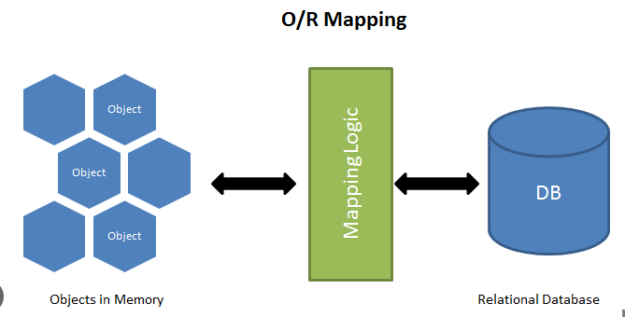

Literature Review Cont’D
Hamming Distance Metric Comparing two binary vectors bit by bit.
Differing bits are assigned value of 1
Similar bits are assigned value of 0
(Ref: Hamming, 1950)
SQL Alchemy Object Relational Mapper (ORM)
Data Storage
Flexibility to Extend
(Ref: Bayer, 2025)
Streamlit Open Source Python Frameworks for Interactive Web Applications
(Ref: Streamlit Community, 2025)
08

Slide 9
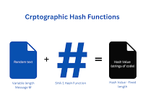
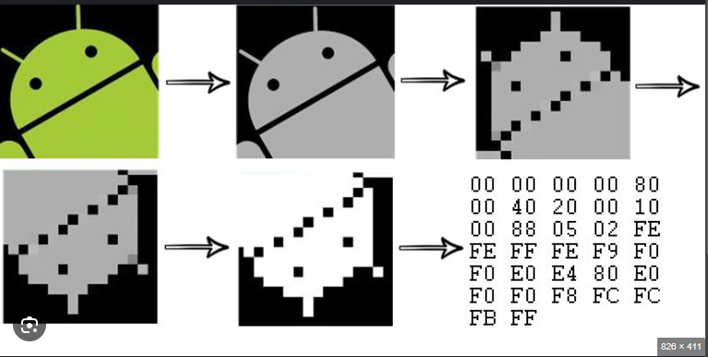
Methodology
Load Images and Image Properties from Data Storage
(Local Drive or Hard Drive)
Compute Cryptographic Hash Values as Key to Store Image Metadata in SQL Database
SHA-256 was used
Compute Perceptual Hashes. Involves creating 3 instances along side original.
Average hash was used.
SQL Alchemy to store Image MetaData and Perceptual Hashes into DB. Cryptographic Hash used as Key
09

Slide 10
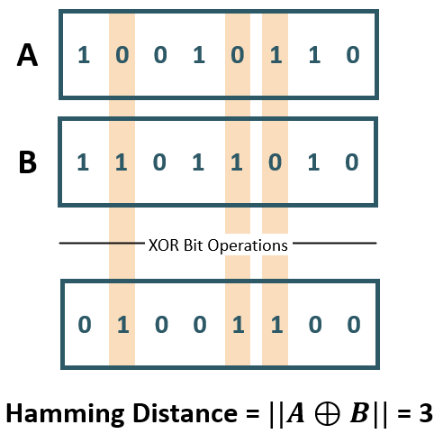
Methodology Cont’D
Distance Metrics
Similarity Threshold
Image Ranking
Visualization
Using Hamming Distance.
Implementing a slider to allow user defined similarity threshold.
Limits of the threshold are based on max. and min. value of the minimum pairwise hamming distance.
From Similar Image Cluster, a ranking criteria is implemented to choose best fit.
This ranking criteria is based on image with best resolution.
Streamlit is used to create web based UI.
This helps users interact with the built algorithm.
Takes in user input and returns output.
10

Slide 11
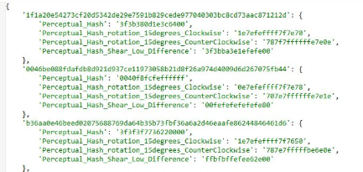
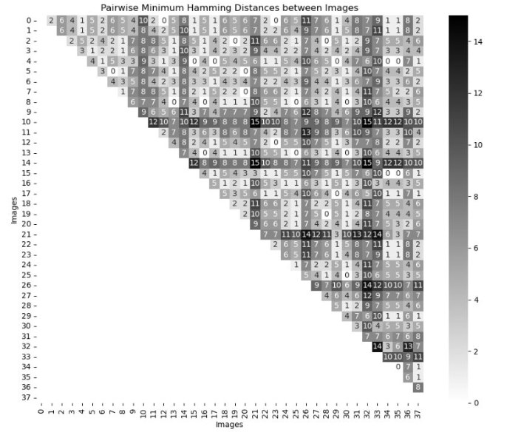
Result and Discussion
Cryptographic Hash Result 64-character long hexadecimal string. Proved effective for storing Images MetaData.
Perceptual Hash Result 16-character long hexadecimal string. Proved effective for detecting similarities between images.
Similarity Measure Hamming Distance was effective in measuring similarity between images. Similarity Matrix was plotted.
Streamlit for Visualization Performed effectively to provide efficient user interaction with algorithm.
11

Slide 12


Result and Discussion Cont’D
12

Slide 13

Result and Discussion Cont’D
13

Slide 14
Conclusions / Findings
Cryptographic Hashes efficient for storing and retrieval of image information
Perceptual Hash effective for identifying Similarities
Hamming Distance proved effective for measuring similarities
SQL Alchemy effective for ORM and Image MetaData Storage
Streamlit provided user friendly GUI
Proposed Hash technique effective for Image Deduplication
14

Slide 15
Limitations of Study
Data Quality Limited Image Dataset Available.
01
04
Best Fit Ranking Image resolution used to rank best version but may not be ideal.
Limitations of Study
Algorithm Complexity Average hash is computationally efficient but not the best. More robust algorithms could be considered
02
05
Image Instance Limited image instance considered which may affect result.
Threshold Selection Threshold used to define similarities could lead to false positives or false negative.
03
06
Clustering Hamming
15

Slide 16
Recommendations
Recommendation 1
Research should be expanded to include more sophisticated algorithms such as pHash to improve accuracy.
Recommendation 2
Exploring modern methods like machine learning-based hashing techniques could offer greater flexibility and adaptability to identify similarities.
Recommendation 3
Future work could involve testing larger and more diverse datasets including images from sources such as social media, scientific data and websites.
16

Slide 17
References
Aradhana and D. S. M. Ghosh. Review Paper on Secure Hash Algorithm With Its Variants. nternational Journal of Technical Innovation in ModernEngineering & Science, 3(5):01–07, Nov. 2021.
S. Sharma. Distance distributions and runtime analysis of perceptual hashingalgorithms. Journal of Visual Communication and Image Representation,104:104310, 2024. doi: 10.1016/j.jvcir.2024.104310.
1
5
2
M. Bayer. SQLAlchemy - The Database Toolkit for Python, 2025. URLhttps://www.sqlalchemy.org/. Version 2.0, Accessed: 2025-03-04.
6
W. Stallings. Cryptography and Network Security: Principles and Practice.Pearson, 7th Global Edition edition, 2017.
V. Viies. Possible Application of Perceptual Image Hashing. Tallinn Universityof Technology, Faculty of Information Technology Department of ComputerEngineering, Master Thesis, 2015.
3
B. Schneier. Applied Cryptography: Protocols, Algorithms and Source Code inC. Wiley, 2017.
7
R. W. Hamming. Error Detecting and Error Correcting Codes. Bell SystemTechnical Journal, 29(2):147–160, 1950.
Streamlit Community. Streamlit: Turn Python Scripts into Beautiful WebApps, 2025. URL https://docs.streamlit.io/get-started. Version1.42.0, Accessed: 2025-02-05.
4
8
17

Slide 18
QUESTIONS
18

Slide 19
THANK YOU
FOR
LISTENING!

